Slide 1
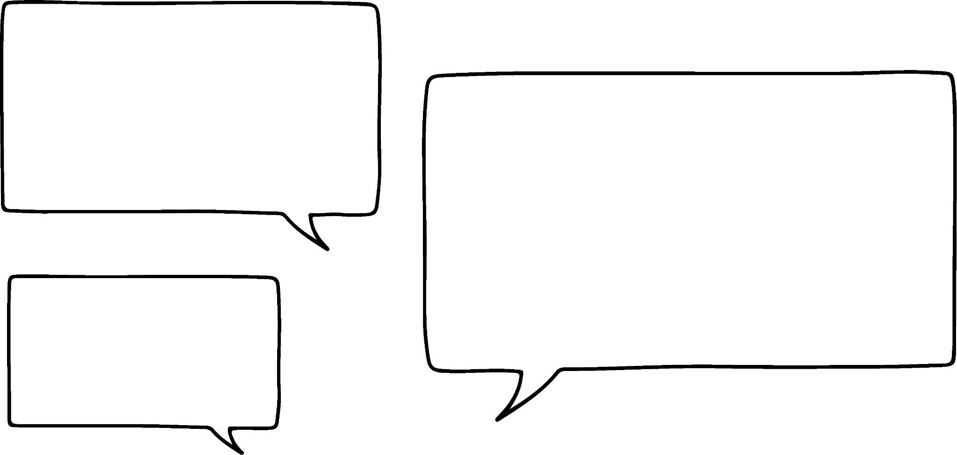
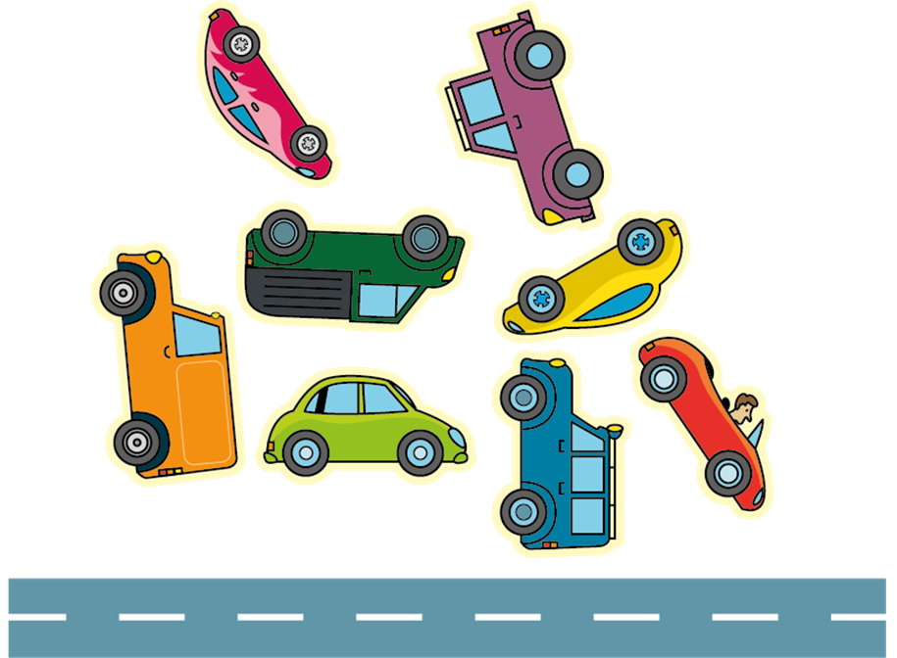
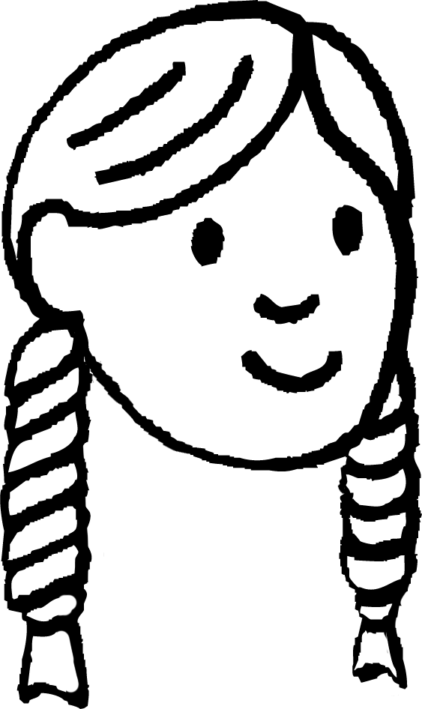
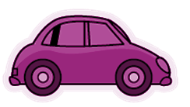
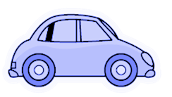
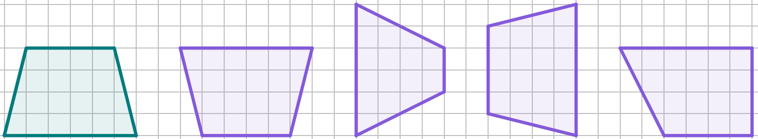



Introduction to rotations
Task A: Identifying rotations in the real world
A
B
I want to rotate all these stickers so that when I stick them into my book, they’re all the right way up with their wheels on the road!
C
D
E
F
H
1) Which vehicles will be facing left, and which will be facing right?
G
Left: A, B, C, E, G
Right: D, F, H
2) Sketch your own vehicles in different orientations.
Can you draw two vehicles that face the same way, even though you have to rotate them differently?
For example:
Both these cars face right when rotated.
Task B: Understanding properties of rotations
1) Select all of the images which are rotations of this trapezium.
a
b
c
d
2) Using a ruler, draw a different correct rotation of the trapezium in the space given.
Draw your own

Slide 2

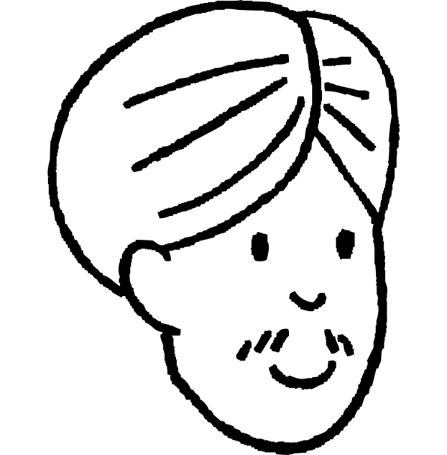
Introduction to rotations
3) The object and all images are rectangles.
Select all of the images which are rotations of this rectangle.
object
cm
4) The object has been rotated to become the image.
Explain why Andeep might be incorrect.
The object and image both look the same, therefore they have the same orientation.
Object and image only have the same orientation if the object has been rotated through one full turn, or multiple full turns.
If it has been rotated by less than that, then the image may look invariant, but still has a different orientation.
Andeep
object
image
5) Complete the table with to show the properties of rotation.
 | Always Invariant | Usually Changes
Lengths of Sides
Size of Angles
Position
Orientation
Mathematics in Education and Industry

